Slide 1
Final Project
Use HTTP protocol to implement media server
0410137 劉家麟

Slide 2
OUTLINE
1. System Configuration
2. Steps in setting up the system
3. How to encode the video for streaming

Slide 3
System Configuration
Introduce the configuration

Slide 4


Configuration
Media Server (Sender)
VLC Player
running on Windows 10
Media Player (Receiver)
PotPlayer
running on Windows 10

Slide 5
Steps
Setting up the system

Slide 6
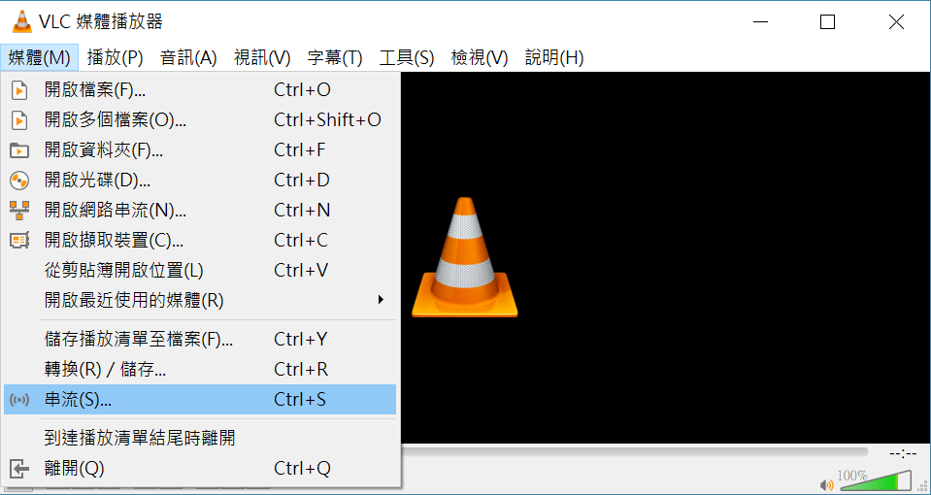
Steps for Media Server (VLC) (1/5)
Open Streaming Function (Ctrl+S)

Slide 7
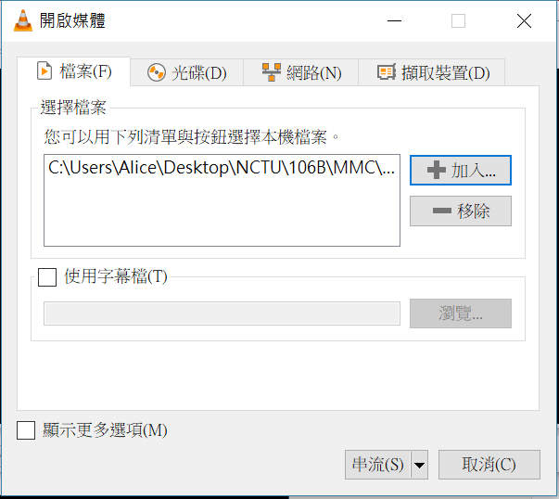
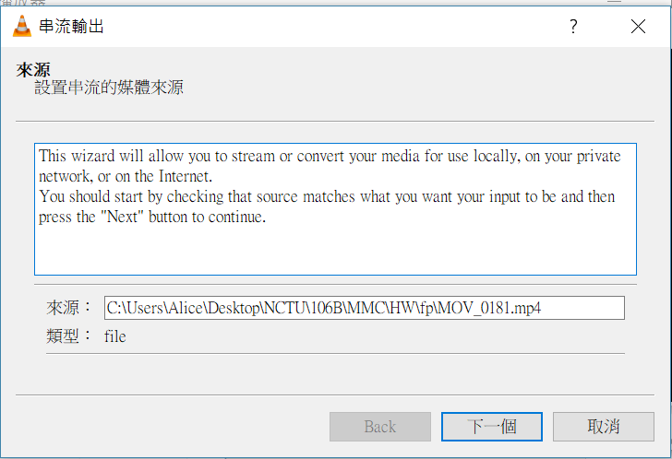
Steps for Media Server (VLC) (2/5)
Add file you want to stream and stream it
1
2
3

Slide 8
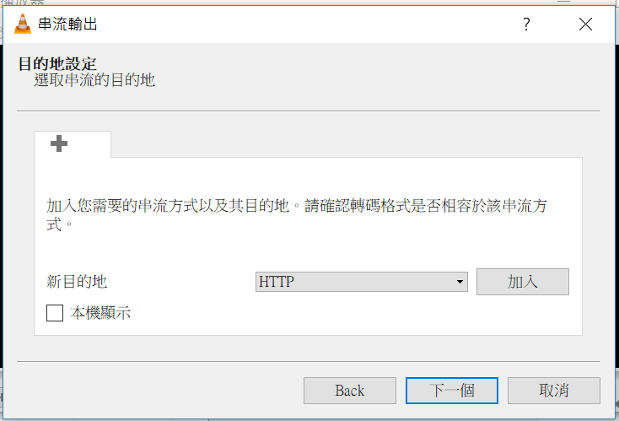
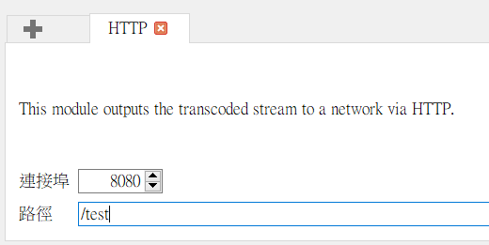
Steps for Media Server (VLC) (3/5)
Set HTTP protocol, port and path name
3
1
2

Slide 9
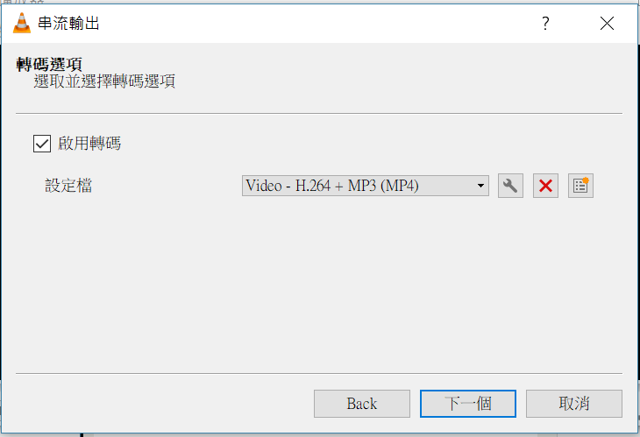
Steps for Media Server (VLC) (4/5)
Choose Encoder (Codec), use H.264+MP4 here

Slide 10
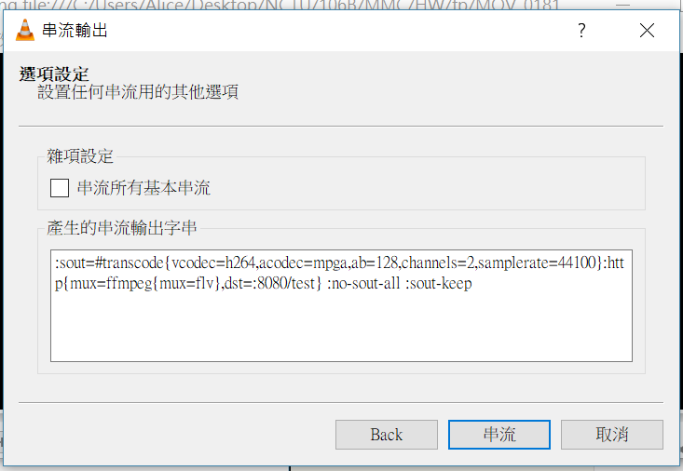
Steps for Media Server (VLC) (5/5)
Choose Encoder (H.264+MP4 here), and stream it

Slide 11
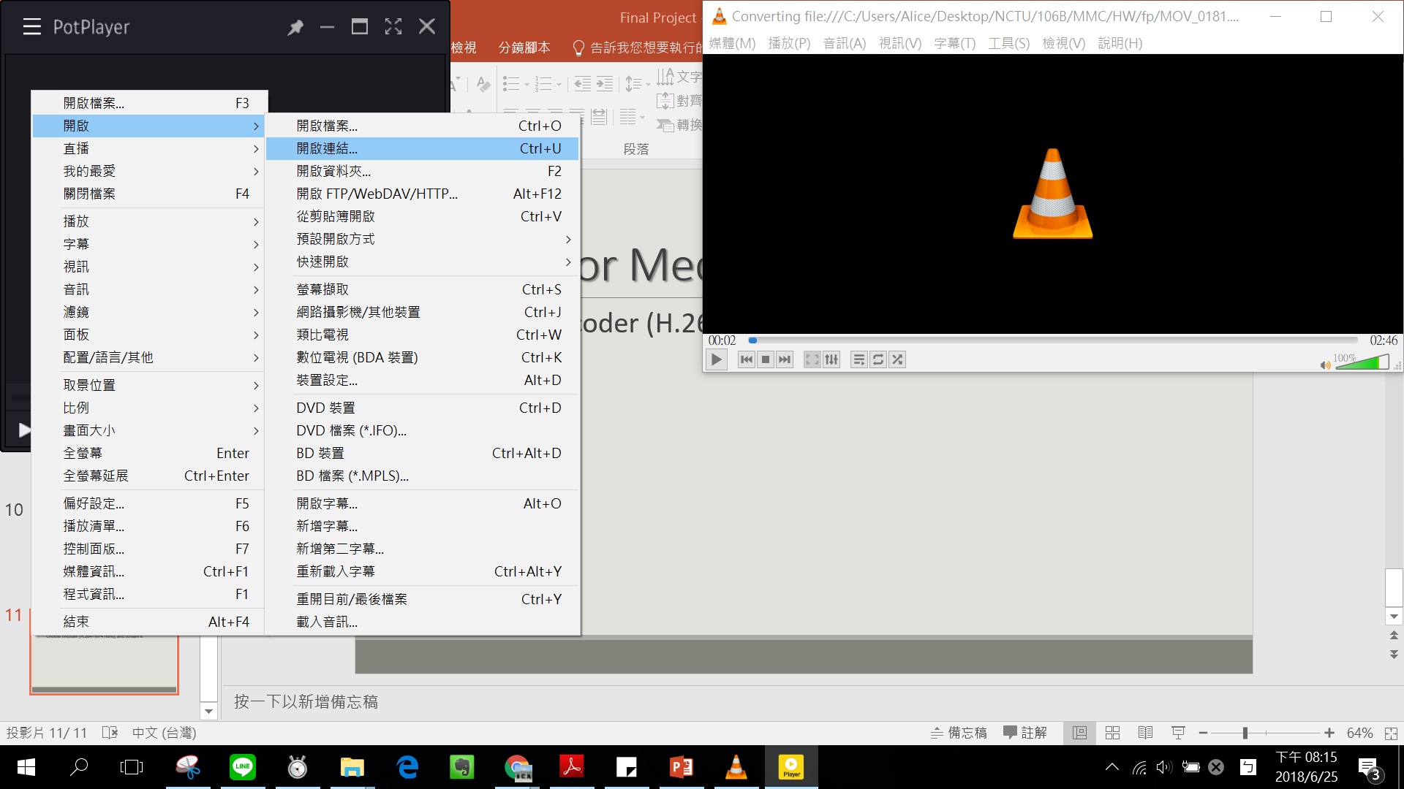
Steps for Media Player (Pot) (1/3)
Open w/ URL to open HTTP stream

Slide 12
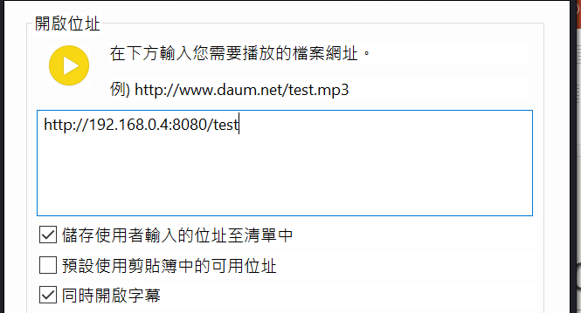
Steps for Media Player (Pot) (2/3)
Type URL: http://your_IP:port/name

Slide 13
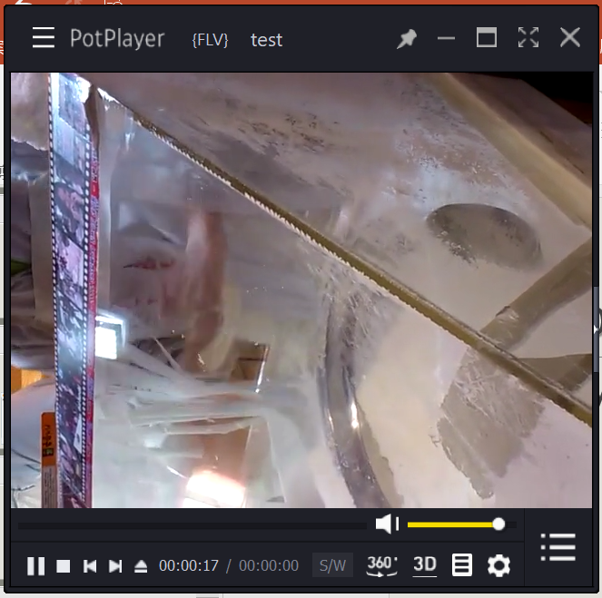
Steps for Media Player (Pot) (3/3)
Then, you can view the video thru HTTP
Video source: shot by myself

Slide 14
How to Encode Video
H.264 / MP4

Slide 15
H.264 / MP4
Just like step 5 of Media Server

Slide 16
H.264 / MP4
- Coding of AV objects
- High compression rate
- Good performance

